Slide 1









Creation of digital twin for industry 4.0 plant using MATLAB and Simulink
Supervisor: Professor Dr.-Ing. Frank Schrödel
Fakultät Maschinenbau
Omar Hussein

Slide 2
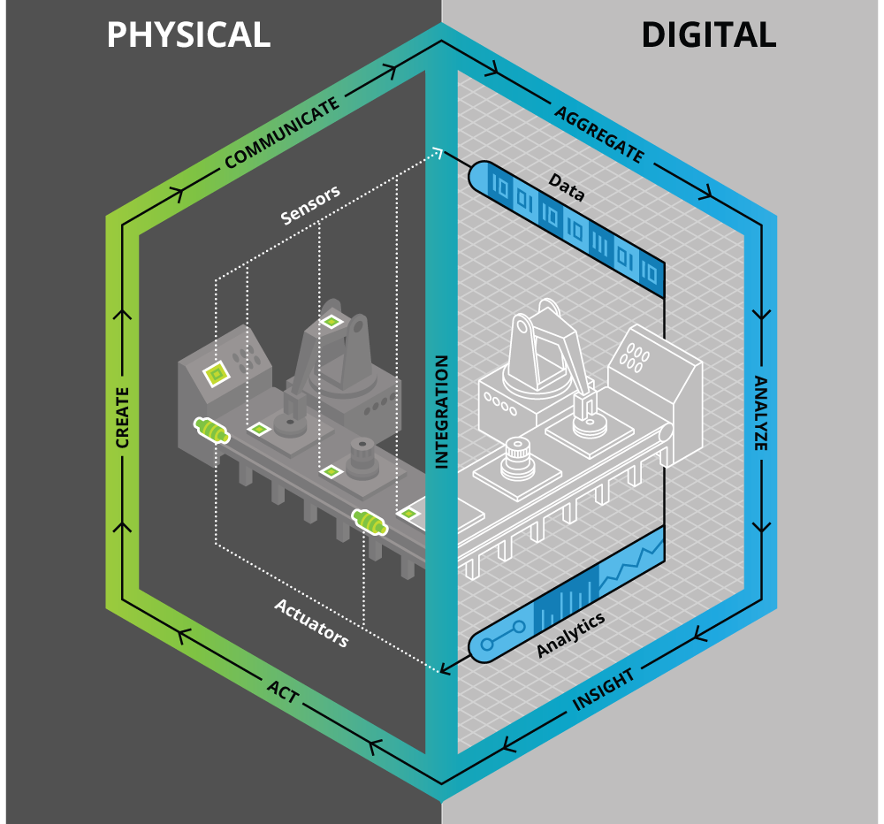
Creation of digital twin for industry 4.0 plant using MATLAB and Simulink
Introduction
Industry 4.0
Digital twin
Problem statement
Plant Architecture
1

Slide 3
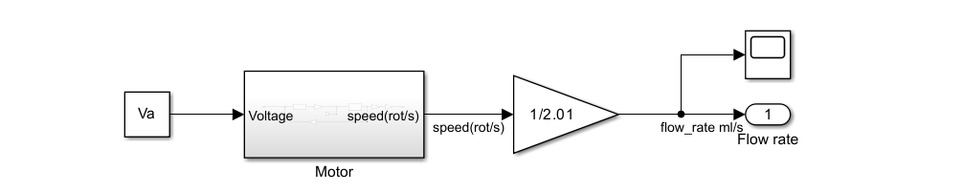
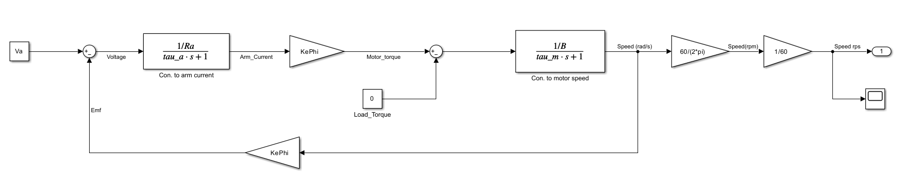
Creation of digital twin for industry 4.0 plant using MATLAB and Simulink
Concept implementation
Connection of the OPC UA protocol
Model of the pump
2

Slide 4
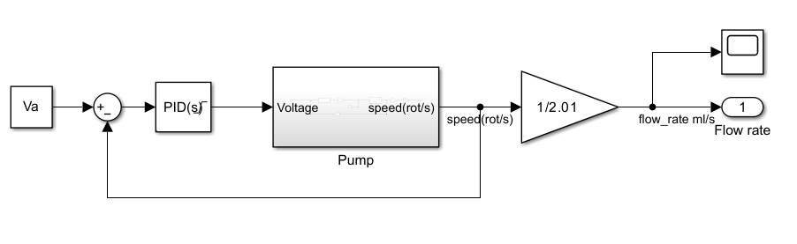
Creation of digital twin for industry 4.0 plant using MATLAB and Simulink
Concept implementation
Model of the pump with PID control block
3

Slide 5
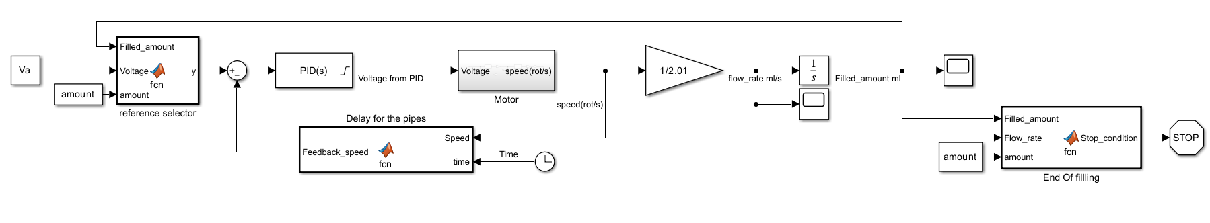
Creation of digital twin for industry 4.0 plant using MATLAB and Simulink
Concept implementation
Model development of the pump
4

Slide 6
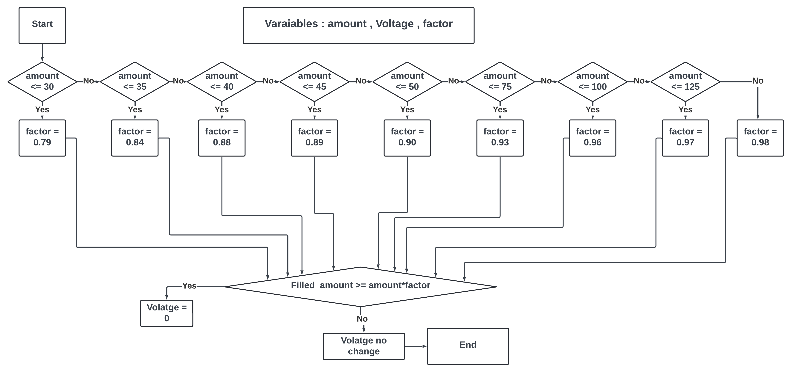
Creation of digital twin for industry 4.0 plant using MATLAB and Simulink
Concept implementation
Voltage terminator with selection of the filled percentage of the required amount to be filled

Slide 7
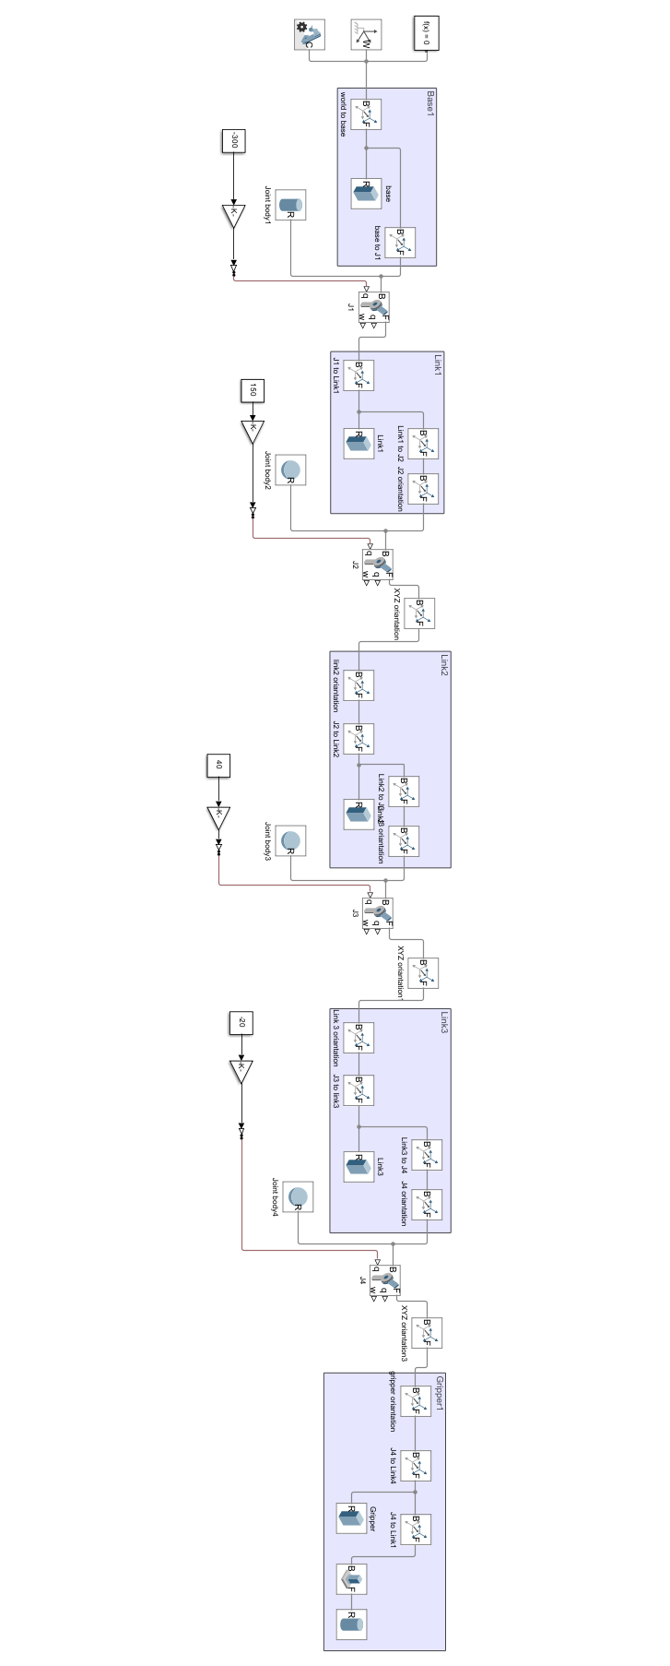
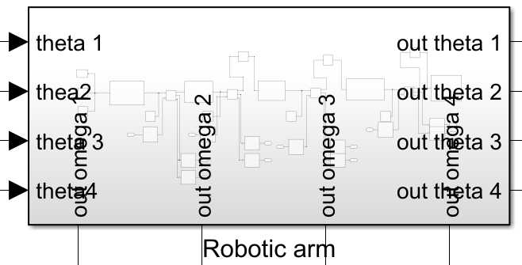
Creation of digital twin for industry 4.0 plant using MATLAB and Simulink
Concept implementation
ASRS 4-DOF robotic arm model
6

Slide 8
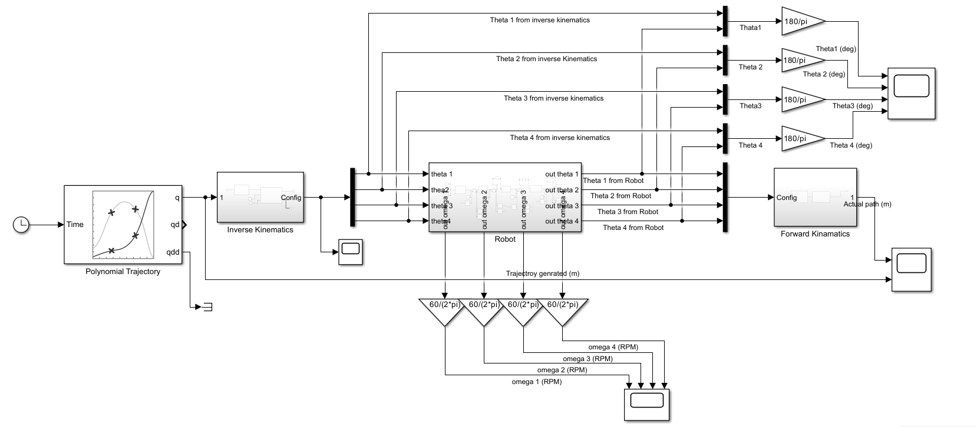
Creation of digital twin for industry 4.0 plant using MATLAB and Simulink
Concept implementation
ASRS 4-DOF robotic arm model
7

Slide 9
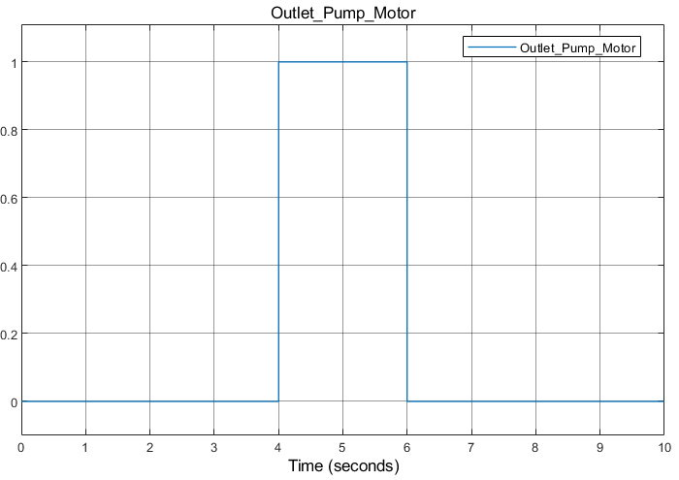
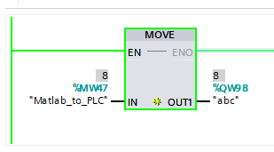
Creation of digital twin for industry 4.0 plant using MATLAB and Simulink
Validation and results
OPC UA
8

Slide 10
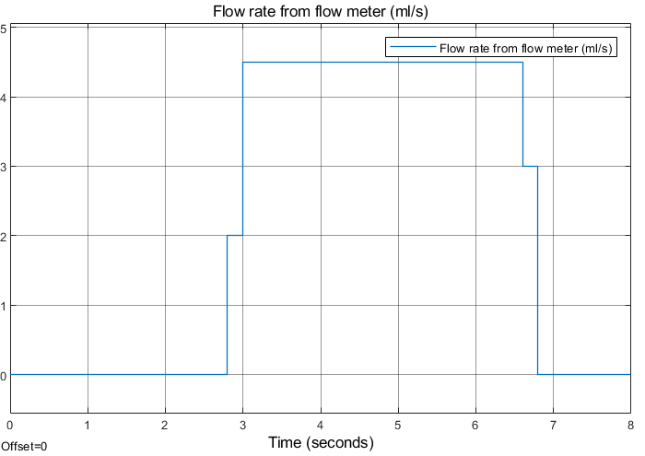
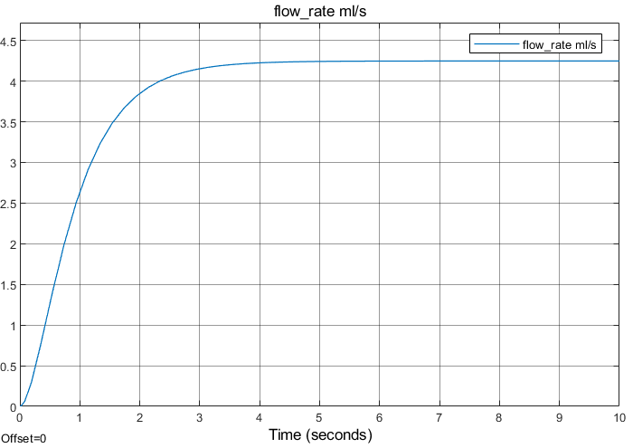
Creation of digital twin for industry 4.0 plant using MATLAB and Simulink
Validation and results
Model of the pump
9

Slide 11
Creation of digital twin for industry 4.0 plant using MATLAB and Simulink
Validation and results
Model development of the pump
Fixed filled amount with different input voltages
Fixed input voltage with different amounts to be filled
10

Slide 12
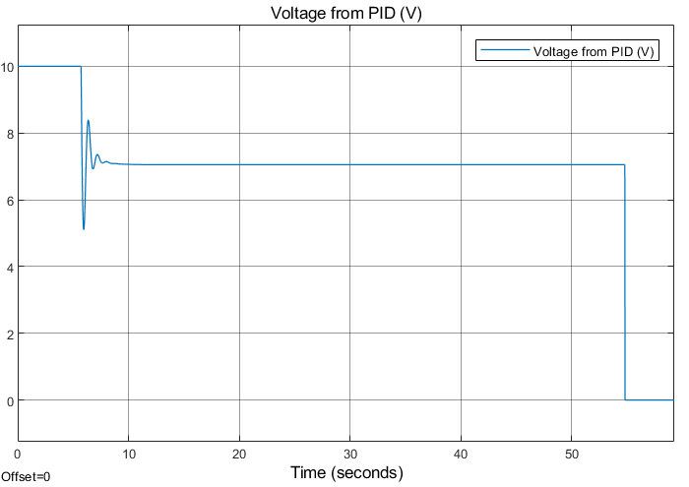
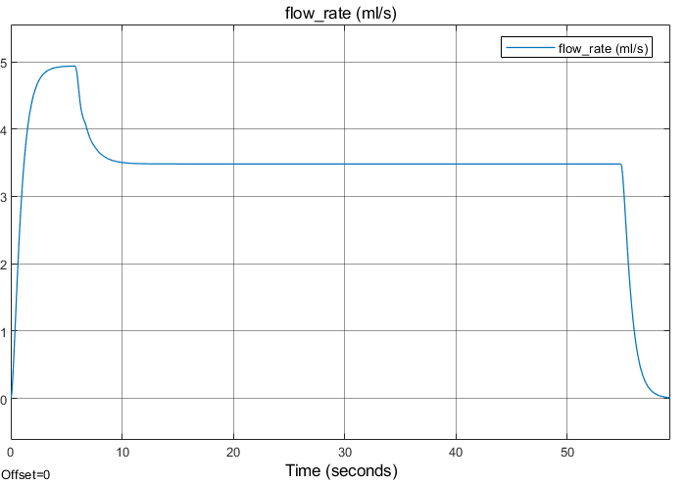
Creation of digital twin for industry 4.0 plant using MATLAB and Simulink
Validation and results
Input voltage: 7V
Filled amount: 200ml
11

Slide 13
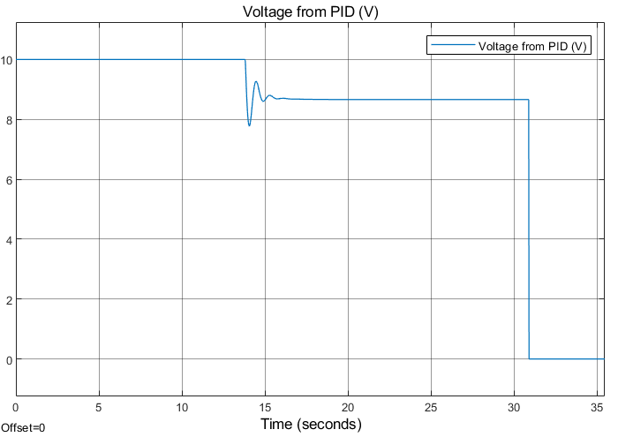
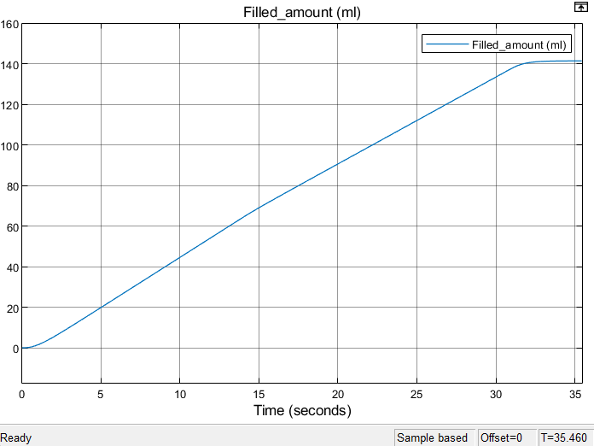
Creation of digital twin for industry 4.0 plant using MATLAB and Simulink
Validation and results
Input voltage: 8.6V
Filled amount: 140ml
12

Slide 14
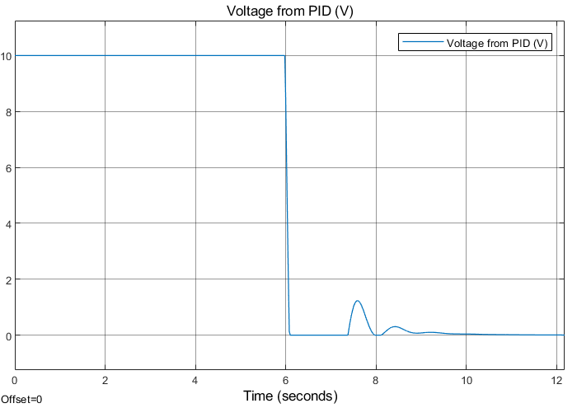
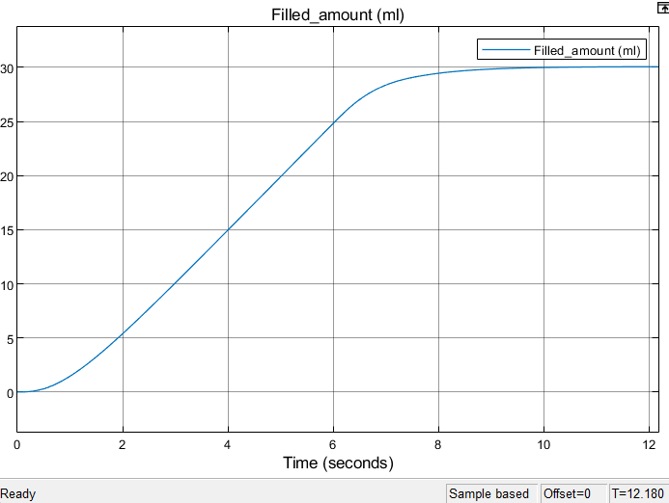
Creation of digital twin for industry 4.0 plant using MATLAB and Simulink
Validation and results
Input voltage: 8.6V
Filled amount: 30ml
13

Slide 15
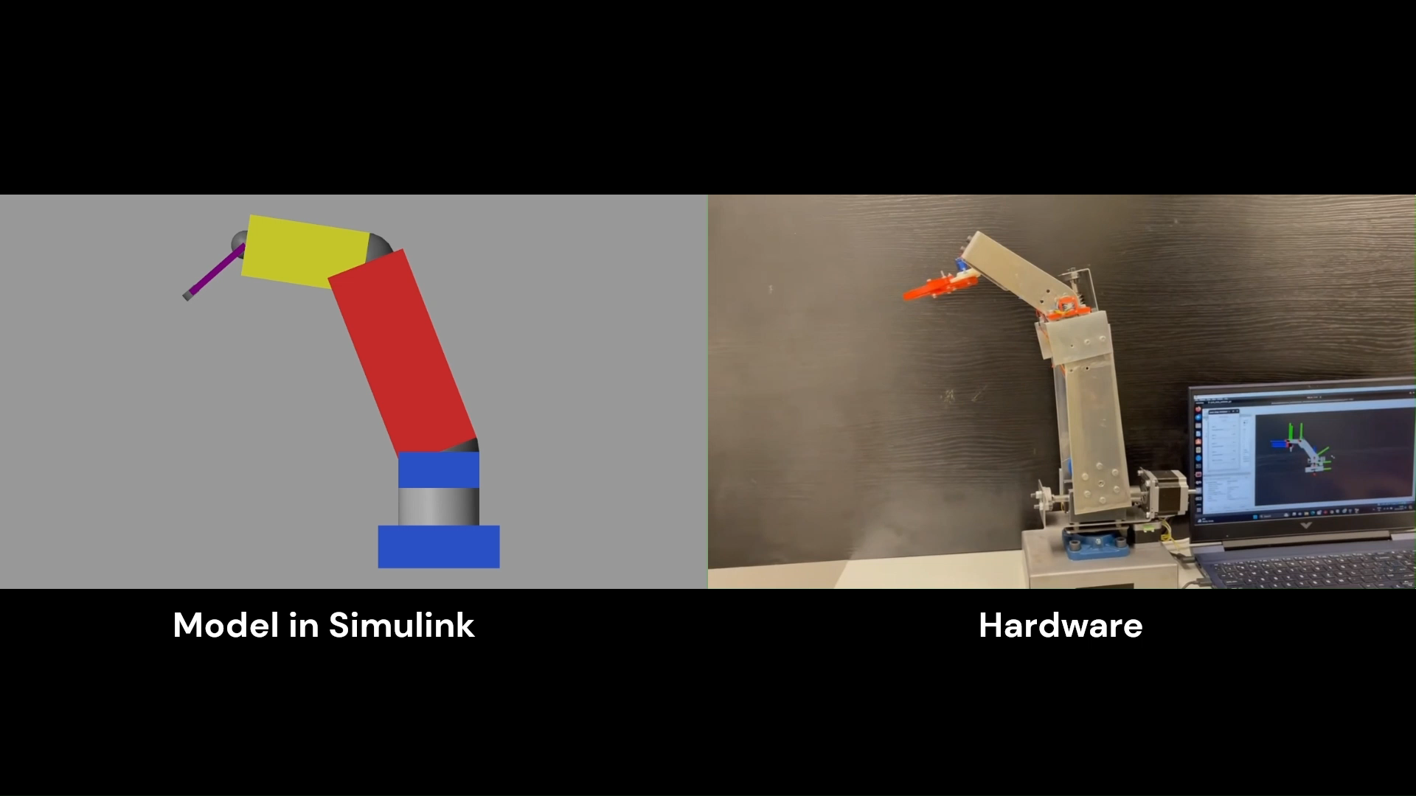
Creation of digital twin for industry 4.0 plant using MATLAB and Simulink
Validation and results
Hardware Vs Simulink model movement 4DOF robotic arm
14

Slide 16
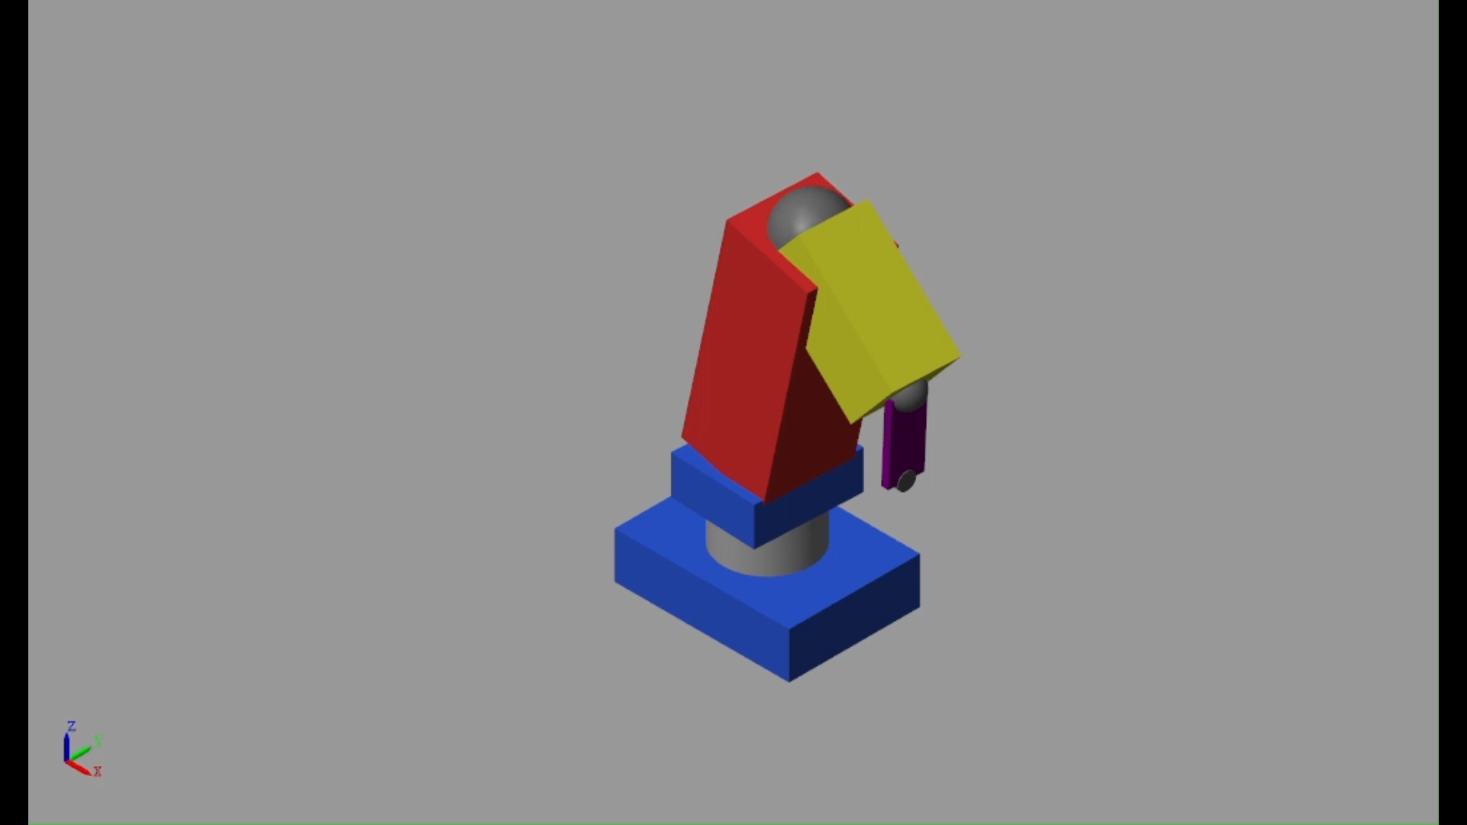
Creation of digital twin for industry 4.0 plant using MATLAB and Simulink
Validation and results
Full trajectory movement on Simulink model
15

Slide 17
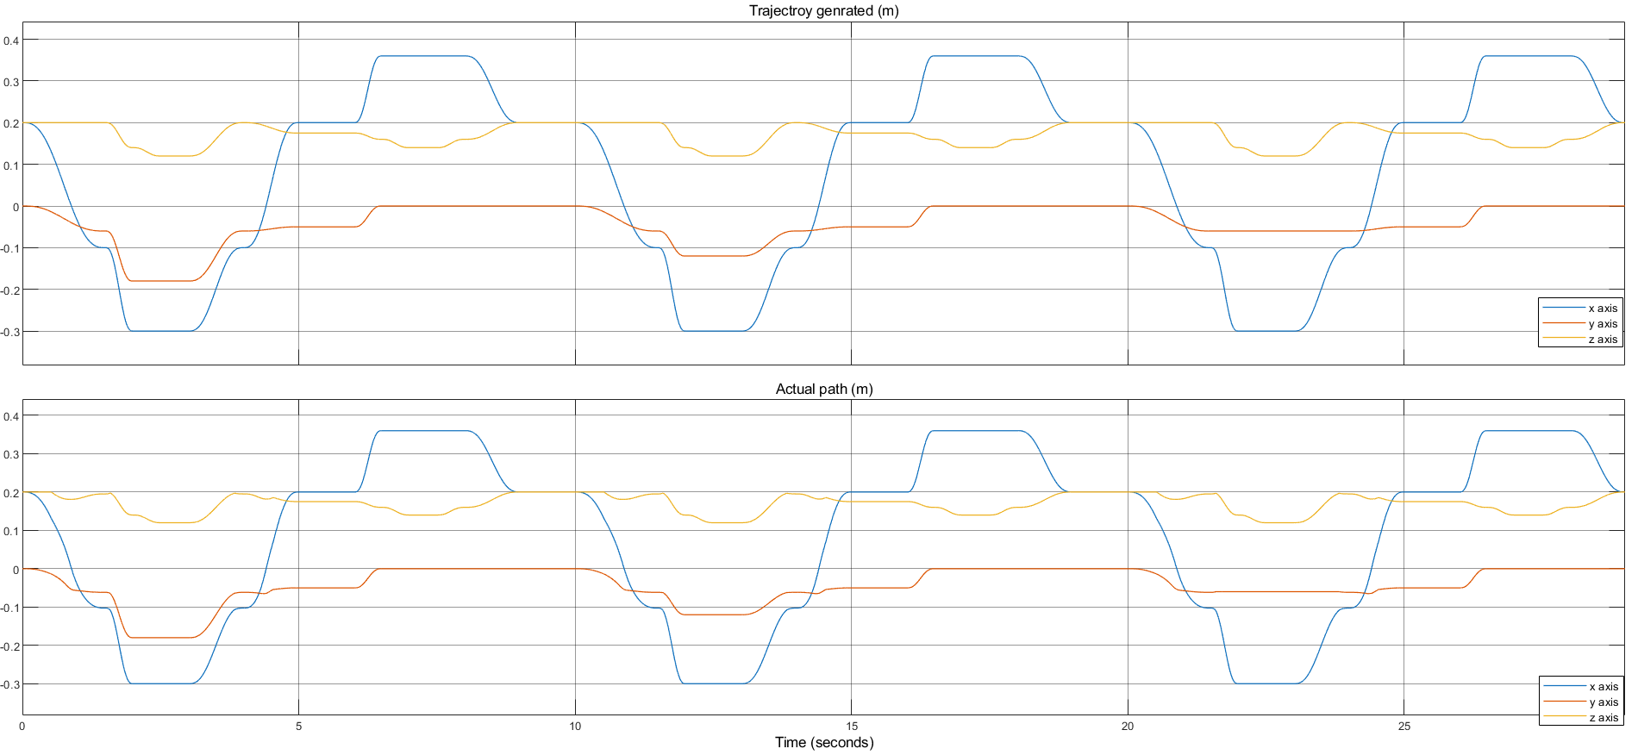
Creation of digital twin for industry 4.0 plant using MATLAB and Simulink
Validation and results
4-DOF robotic arm

Slide 18
Creation of digital twin for industry 4.0 plant using MATLAB and Simulink
Conclusion
16

Slide 19
Thank you
Contact Information:
omarmontasser51@gmail.com

Slide 20
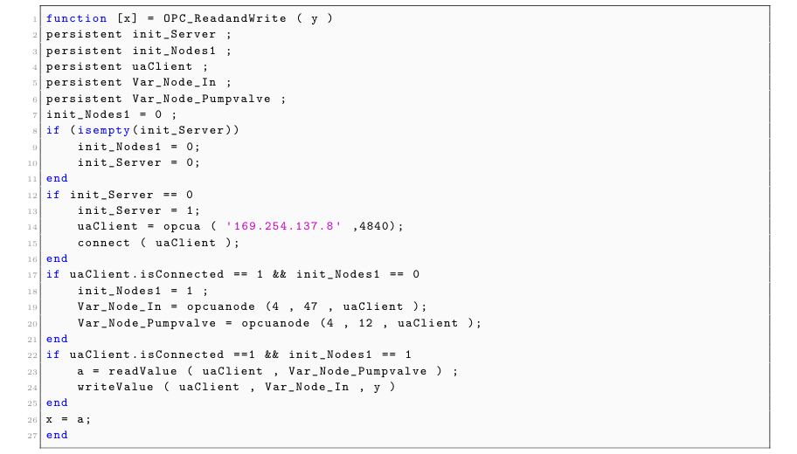
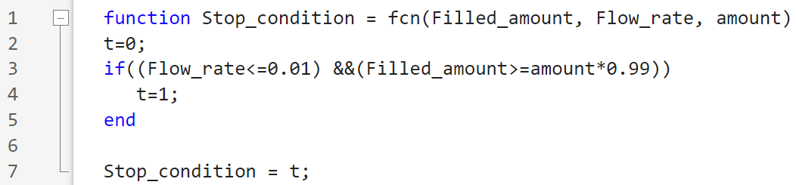
Creation of digital twin for industry 4.0 plant using MATLAB and Simulink
Appendix :
17

Slide 21
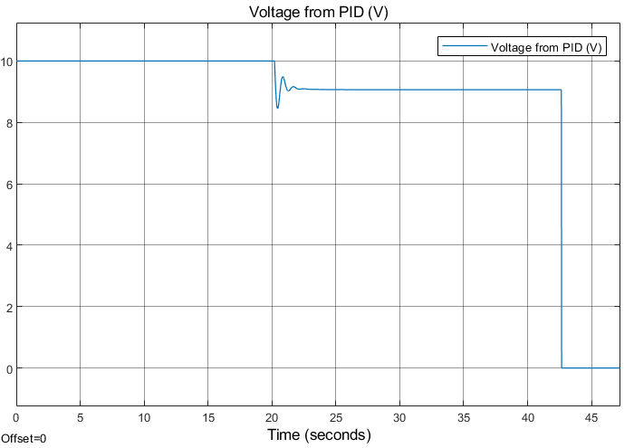
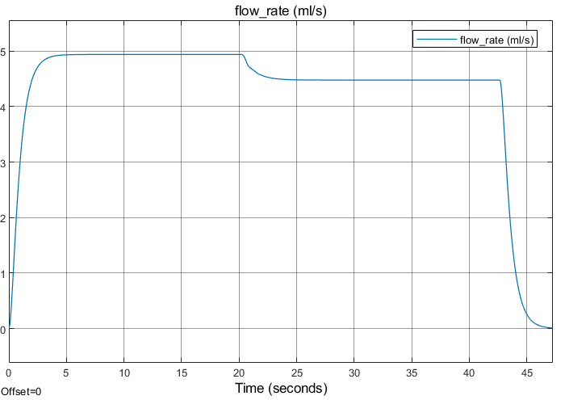
Creation of digital twin for industry 4.0 plant using MATLAB and Simulink
Appendix :
18

Slide 22
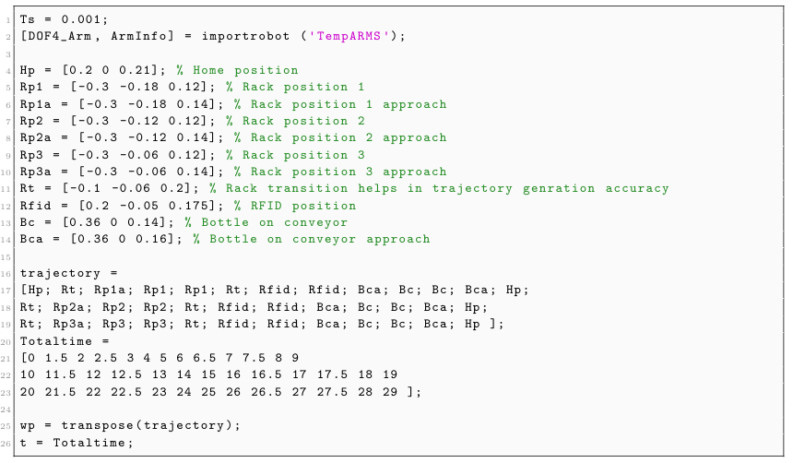
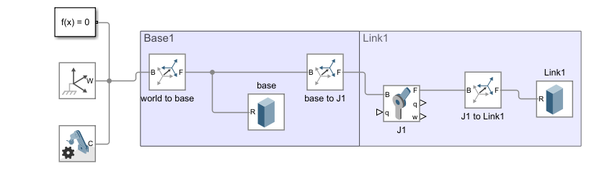
Creation of digital twin for industry 4.0 plant using MATLAB and Simulink
Appendix :
19

Slide 23
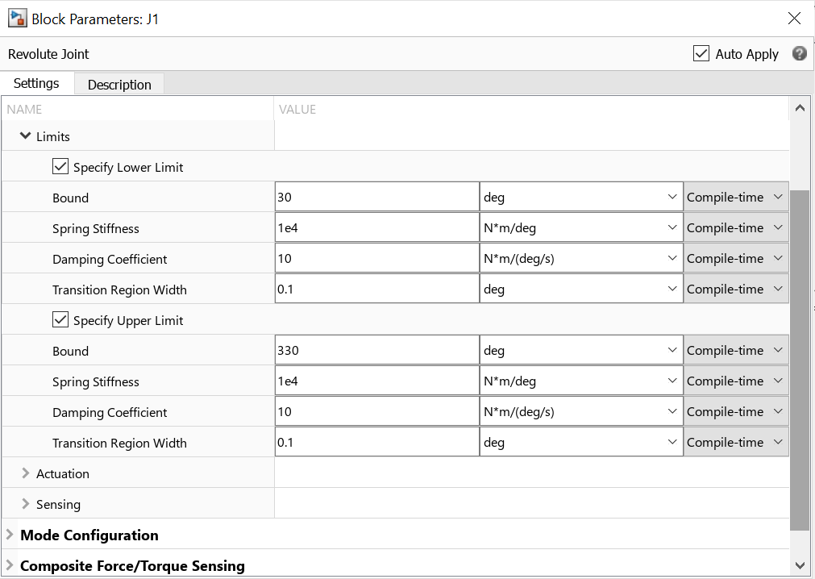
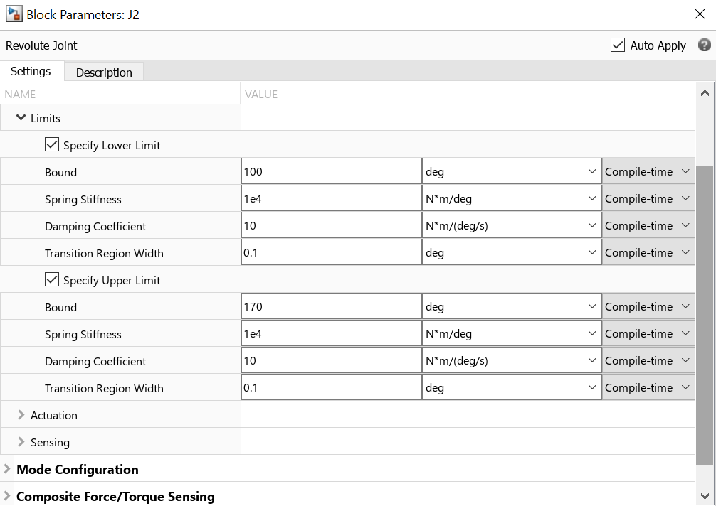
Creation of digital twin for industry 4.0 plant using MATLAB and Simulink
Appendix :
20

Slide 24

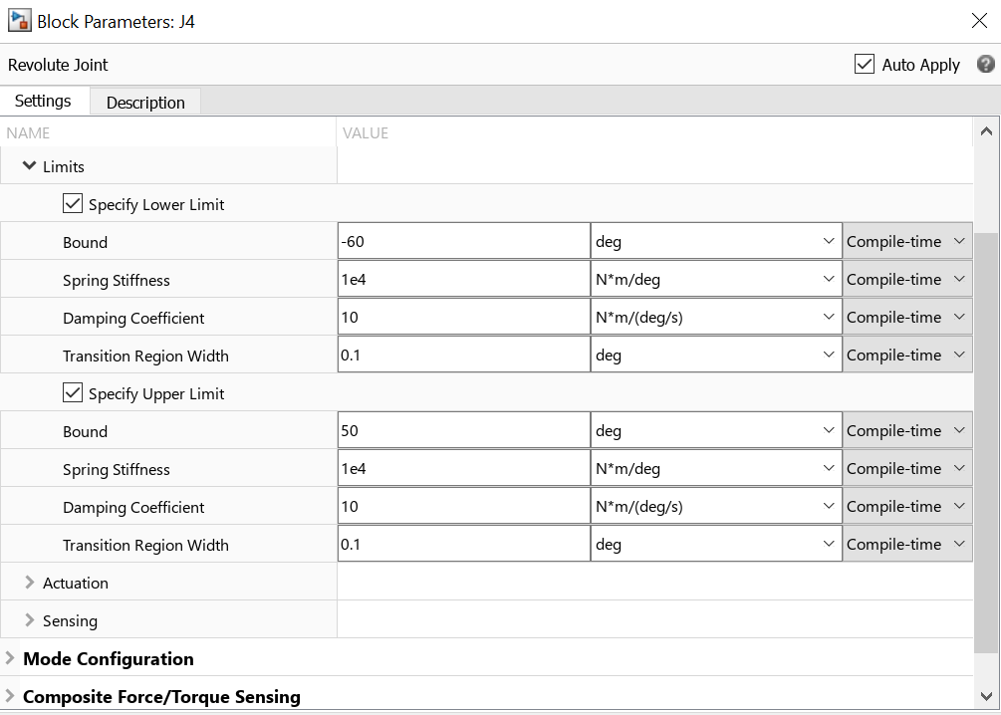
Creation of digital twin for industry 4.0 plant using MATLAB and Simulink
Appendix :
21

